Slide 1

Advanced Traffic Signal Control System.
Urban traffic congestion represents one of the most persistent challenges in modern cities, affecting millions of commuters daily. Traditional traffic management systems rely on fixed-time signals that operate on predetermined cycles, unable to respond to the dynamic nature of real-world traffic patterns.
This project introduces an intelligent solution that combines artificial intelligence-based vehicle detection with embedded electronics to create an adaptive traffic control system. By analyzing real-time traffic density and dynamically adjusting signal timings, the system optimizes traffic flow, reduces unnecessary waiting times, and improves overall road efficiency in urban environments.

Slide 2

The Problem with Traditional Traffic Signals
Static Operation Model
Real-World Consequences
Conventional traffic lights operate on pre-programmed, fixed-duration cycles that remain constant throughout the day. These systems cannot perceive or respond to actual vehicle presence, leading to significant inefficiencies during both low and peak traffic periods.
The inability to adapt creates cascading problems: vehicles wait unnecessarily at red lights when no cross-traffic exists, peak hours experience extended delays, fuel consumption increases during idle periods, and driver frustration grows with unpredictable wait times.
Excessive Wait Times
Fuel Wastage
Congestion Buildup
Vehicles stop at red lights even when roads are empty, wasting valuable time
Prolonged idling during unnecessary red cycles increases fuel consumption
Fixed timings fail to accommodate varying traffic density throughout the day
The solution requires a dynamic system that automatically adjusts signal timings based on real-time vehicle detection and intelligent traffic analysis.

Slide 3
Project Objectives
This project establishes five core technical objectives that work together to create a fully functional adaptive traffic control system. Each objective addresses a specific aspect of the system architecture, from vehicle detection through to precise signal synchronization.
01
02
03
Real-Time Vehicle Detection
Dynamic Signal Adjustment
Master-Slave Communication
Implement YOLO object detection model with camera feed to accurately detect and count vehicles in each traffic lane
Develop algorithms to automatically calculate and adjust green, yellow, and red light durations based on detected traffic density
Design reliable serial communication protocol between Master Arduino and multiple Slave controllers for coordinated operation
04
Precise Synchronization
Establish hardware-based timing synchronization to ensure exact coordination between multiple signal systems

Slide 4




System Architecture Overview
The system employs a modular, layered architecture that separates concerns between detection, decision-making, and actuation. This design approach provides scalability, maintainability, and clean signal management across all components.
Video Acquisition Layer
Mobile phone camera captures live video stream and transmits it to the processing system via IP Webcam or similar application
Control Logic Layer
Master Arduino receives vehicle counts via serial communication, computes optimal signal timings, and coordinates Slave controllers
Actuation Layer
Two Slave Arduinos execute final light switching commands using MOSFET drivers, controlling high-current traffic LED modules
Architectural Advantage: The separation between detection, computation, and actuation allows independent testing, easy debugging, and future expansion to additional intersections or signal groups.

Slide 5

System Working Principle
Detection Phase
The camera continuously captures traffic conditions at the intersection. The YOLO model processes frames in real-time, detecting vehicles with high accuracy and generating vehicle counts for each road direction.
Decision Phase
The Master Arduino analyzes received vehicle counts and applies dynamic timing algorithms. Roads with higher vehicle density receive proportionally longer green light durations, optimizing overall traffic throughput.
Frame Capture
1
Camera streams live video at 15-30 fps
2
Vehicle Detection
YOLO processes frames and counts vehicles
Data Transmission
3
Counts sent to Master Arduino via serial
4
Timing Computation
Master calculates optimal signal durations
Command Distribution
5
Instructions sent to Slave controllers
6
Signal Execution
Switch traffic LEDs precisely
After computing the complete signal cycle, the Master Arduino transmits commands to both Slave Arduinos along with a SYNC pulse. This hardware synchronization signal ensures both traffic directions switch states simultaneously, maintaining safe and coordinated intersection operation. The Slaves then drive their respective traffic LEDs using MOSFET power switches.

Slide 6
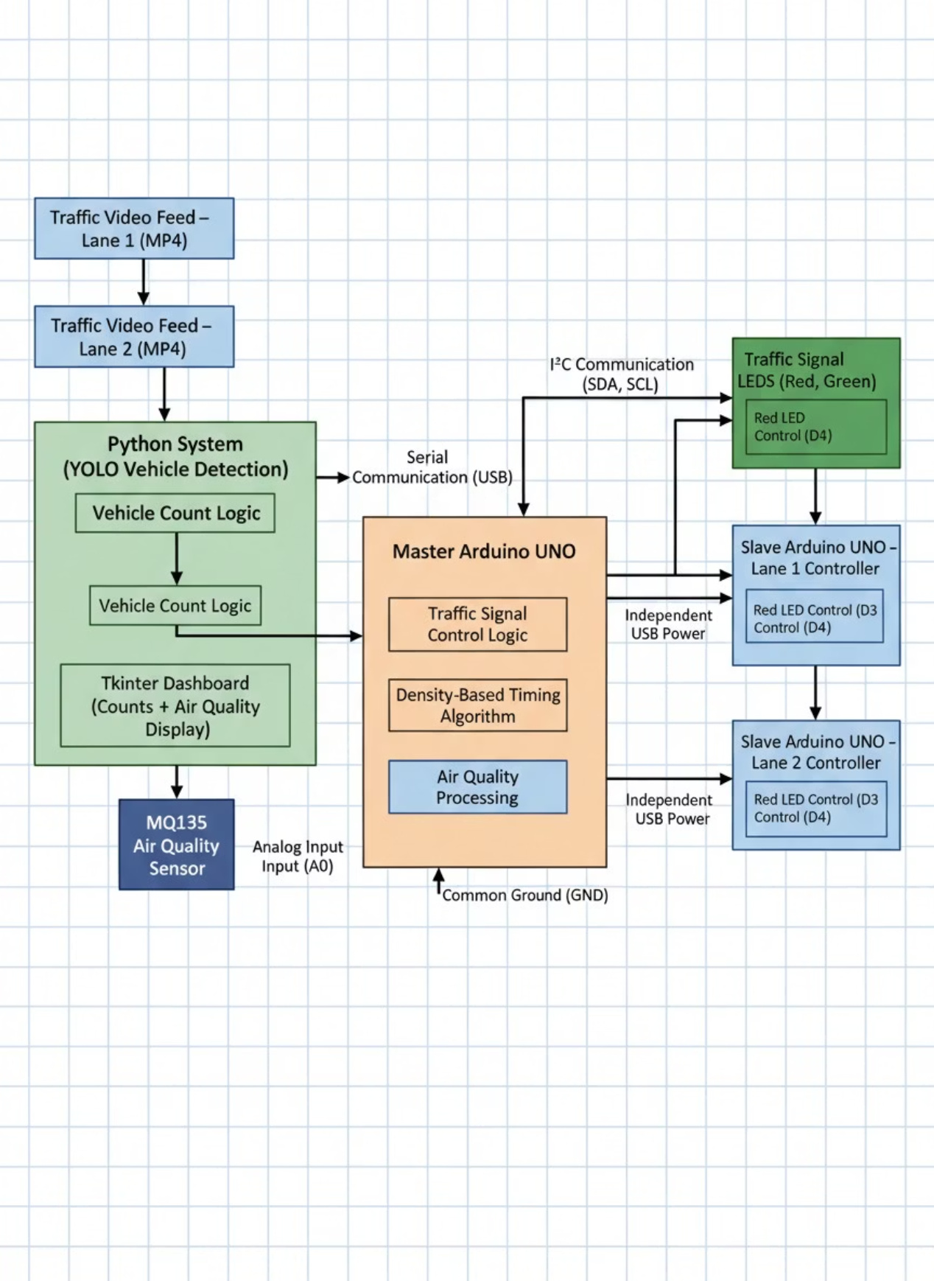
Block Diagram :

Slide 7
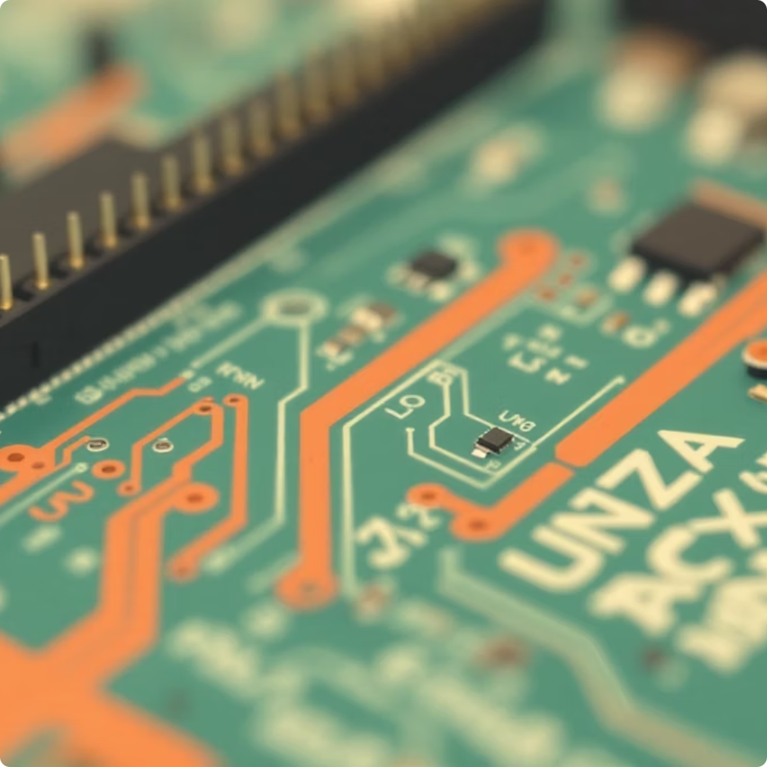


Hardware Components
The system integrates carefully selected electronic components that work together to provide reliable detection, control, and power switching. Each component plays a specific role in the overall architecture.
Three Arduino Boards
LED Traffic Modules
One Master controller for decision logic, two Slave controllers for independent signal management
High-brightness LED arrays or complete traffic light modules for clear visibility
Supporting Components
Design Consideration: MOSFET selection requires attention to voltage rating (≥50V), current capacity (≥2A per LED), and gate threshold voltage (logic-level MOSFETs recommended for 5V Arduino operation).
Resistors: Gate pull-down resistors (10kΩ) prevent floating MOSFET gates
Power Supply: Direct Power From Laptop's USB
Breadboard: Mounting platform for reliable connections
Connecting Wires: Quality jumper wires and terminal blocks

Slide 8
Software Architecture
YOLO Detection Model
Python Processing Script
Pre-trained deep learning model ( YOLOv8) optimized for real-time vehicle detection with 30+ fps processing capability
Handles video stream acquisition, frame preprocessing, YOLO inference, vehicle counting, and serial communication with Master Arduino
Arduino Firmware
Serial Protocol
Master code implements timing algorithms and communication protocol; Slave code handles SYNC detection and Traffic Signal control logic
Custom packet structure defining data exchange format, error checking, and command syntax between laptop and microcontrollers
Software Integration Flow
The Python script continuously processes video frames, extracting vehicle counts for each monitored direction. These counts are packaged into serial data packets and transmitted to the Master Arduino at regular intervals (typically every 2-5 seconds). The Master Arduino parses incoming data, validates packet integrity, and executes the timing computation algorithm.
Upon completing calculations, the Master generates command packets for each Slave Arduino, specifying the duration and sequence of traffic signal states. A hardware SYNC pulse accompanies these commands, providing a precise timing reference. The entire software stack ensures real-time operation with minimal latency between detection and signal adjustment.

Slide 9
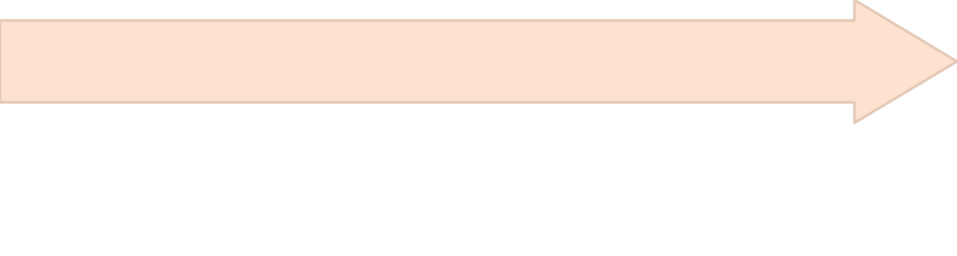
Synchronization Methodology
Precise synchronization between multiple Slave Arduinos represents a critical design challenge. Without coordination, traffic signals could conflict, creating dangerous intersection conditions. This system employs a hardware-based synchronization approach that guarantees simultaneous state transitions.
Coordinated Execution
Simultaneous Detection
Upon detecting the SYNC pulse, both Slaves simultaneously reset their internal timers and begin executing their respective signal sequences in perfect alignment
Master Generates Pulse
Both Slave Arduinos monitor this SYNC pin using interrupt-driven detection, ensuring immediate response to the rising edge with minimal latency
After computing the complete signal cycle, the Master Arduino outputs a brief digital pulse (50-100ms duration, rising edge) on a dedicated SYNC pin
Hardware Implementation
Timing Accuracy
The SYNC signal uses a direct digital connection from the Master Arduino's output pin to input pins on both Slave Arduinos. Pull-down resistors ensure the line remains at a defined LOW state when idle, preventing false triggers from electrical noise.
Hardware-based synchronization achieves sub-millisecond accuracy, far superior to software-based polling methods. This precision ensures traffic signals never display conflicting states, maintaining intersection safety even with dynamic timing adjustments.

Slide 10
Conclusion and Future Outlook
This project successfully demonstrates the integration of artificial intelligence, embedded systems, and power electronics to solve a practical urban infrastructure challenge. By combining YOLO-based vehicle detection with Arduino-controlled signal management, the system overcomes the fundamental limitations of traditional fixed-time traffic signals.
✓ Real-Time Adaptation
✓ Precise Coordination
✓ Scalable Architecture
Responds dynamically to changing traffic density, reducing unnecessary wait times and improving traffic flow efficiency
Hardware synchronization ensures multiple signal controllers operate in perfect alignment, maintaining intersection safety
Modular design allows expansion to additional intersections, integration with city-wide systems, or enhancement with additional sensors
Practical Impact
The system represents a modern, cost-effective approach to intelligent traffic management. Unlike expensive commercial solutions, this implementation uses readily available components and open-source software, making it accessible for educational projects, pilot programs, or deployment in developing regions.
Future enhancements could include pedestrian detection, emergency vehicle prioritization, vehicle-to-infrastructure (V2I) communication, and integration with smart city platforms for comprehensive urban mobility management.

